Slide 2
KEY FACTS RELATING TO ESG AND SUSTAINABILITY
According to Gartner’s Annual CEO survey, Environmental sustainability has hit the top 10 priorities list of CEO priorities.
In 2015 UK proposed CARBON NEUTRAL plan to achieve by 2030
The top 10% of companies in terms of ESG performance have a lower cost of capital and a higher return on equity than the bottom 10%

Slide 3
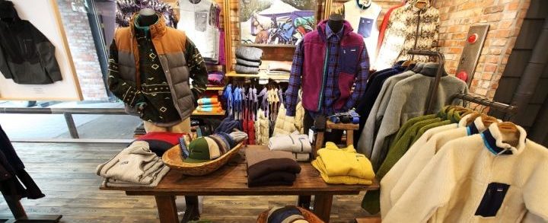

Slide 4
REDUCE YOU don’t buy what you don’t need.
REPAIR WE help you repair your Patagonia gear.
REUSE
WE help find a home for Patagonia gear you no longer need. YOU sell or pass it on.
RECYCLE WE will take back your Patagonia gear that is worn out.
REIMAGINE TOGETHER we reimagine a world where we take only what nature can replace.

Slide 5
KEY FACTS RELATING TO ESG
1% Earth Tax
Used only organic cotton and recycled poleyster
Fair labour practices
Wong wear programme

